Slide 1
Turing Machines
CSCI 265 Lecture 7
By Ariel Avshalom

Slide 2
Previously…
We covered CFGs and PDAs
Which
Recognize context free languages
Are equivalent
Now, we’ll go onto the next step

Slide 3
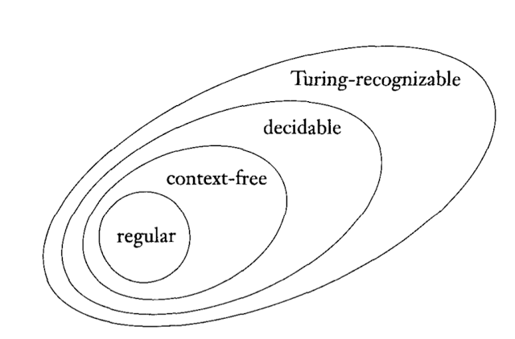

Slide 4
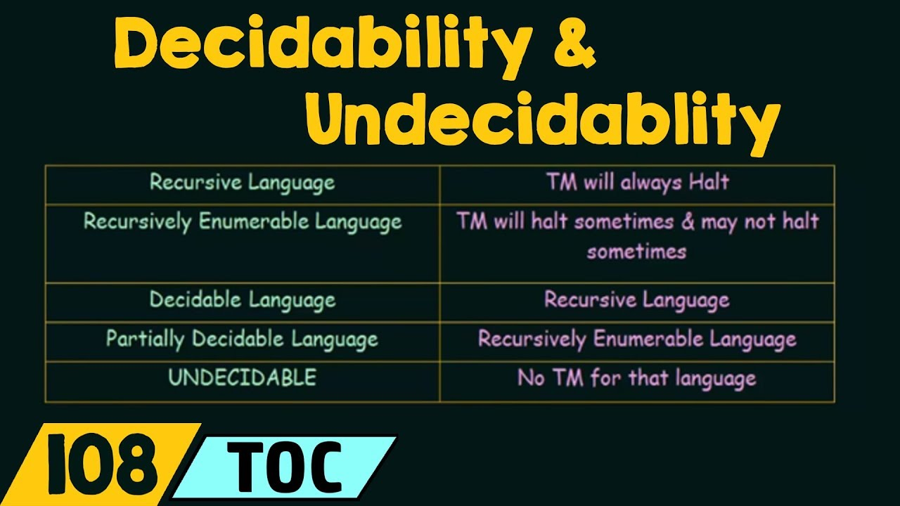

Slide 5
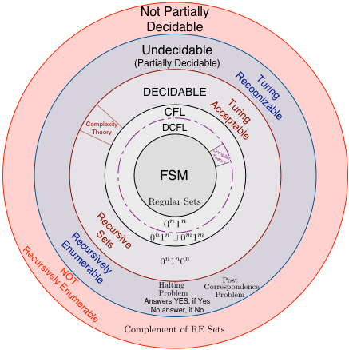

Slide 6
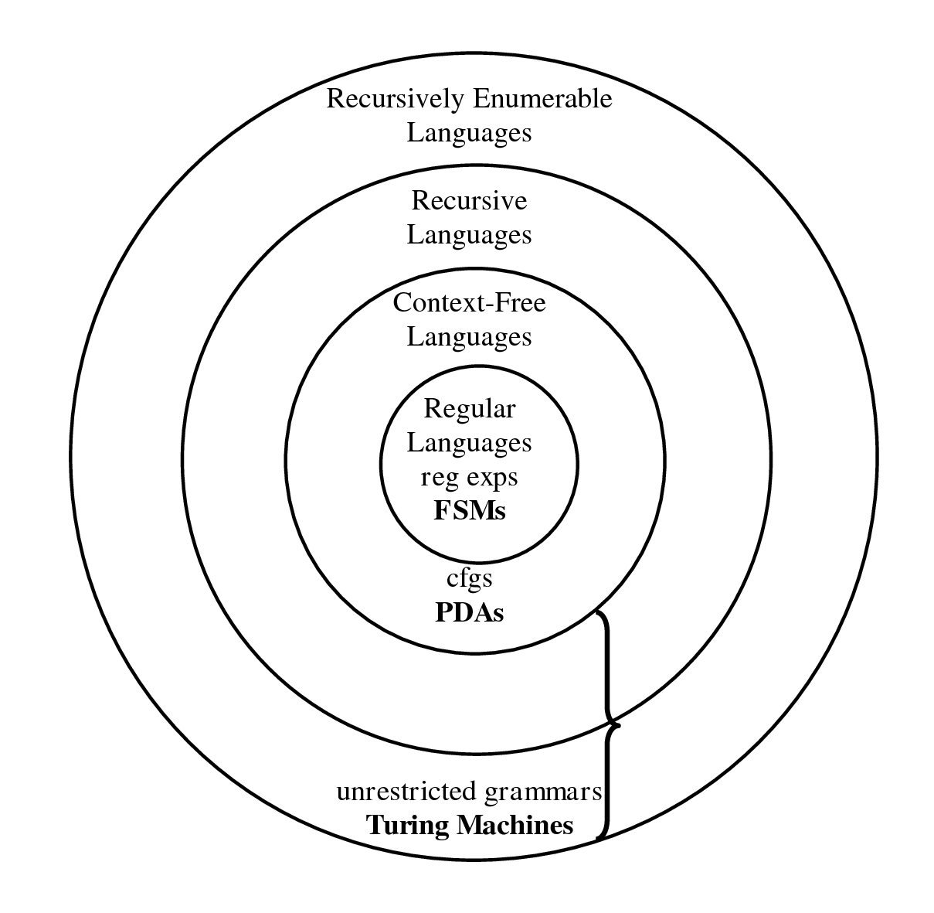
In short:

Slide 7
What is a Turing Machine?
It’s a mathematical model of computation that is equivalent to any computer we have today
You’re given a tape and you manipulate the symbols on that tape based on a certain set of rules

Slide 8
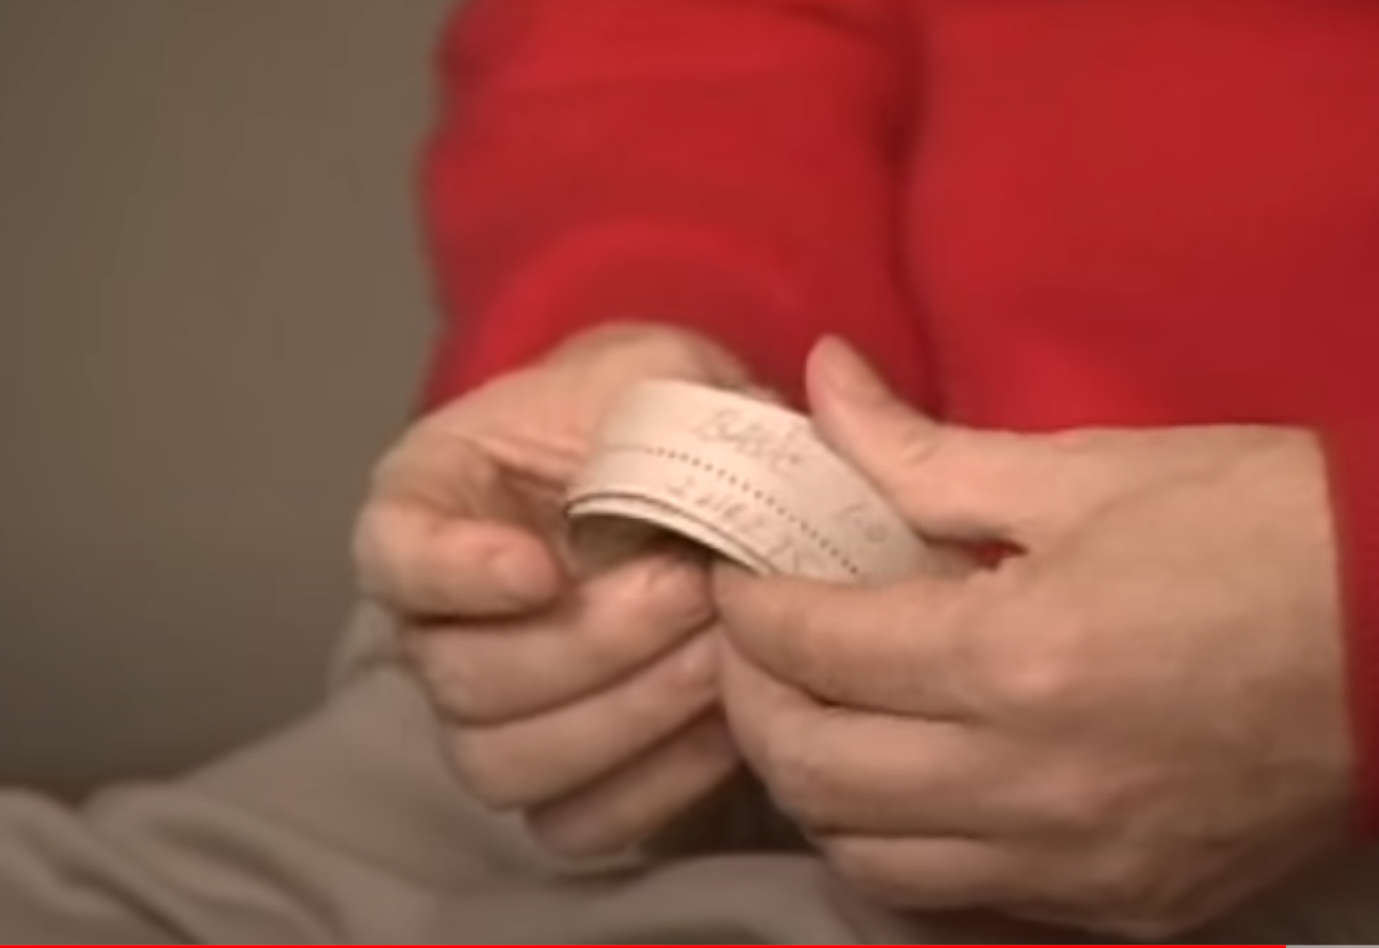
Bill Gates and the DOS bootstrapper
Once upon a time, we used to feed computers instructions on tapes
This is why we think of Turing machine inputs as tapes
Bill Gates was flying to IBM to showcase DOS to them
He failed to write a bootstrapper into his very expensive 4kb tape
Paul Allan thought up the bootstrapper and Bill Gates wrote it up on the plane ride to IBM
It looked like this:

Slide 9
FA vs PDA vs TM
So far we see that
An FA has extremely limited memory
A PDA has unlimited memory but it can only store information in a stack
Now, its time to learn a more complex and general model:
Turing machines (TM) can do everything a real computer can do
But even so, as we have seen there are a class of problems even these machines can’t do…
This video will be a great start to learn the new terms we’re considering
Note: it delves into more than we need for this class

Slide 10
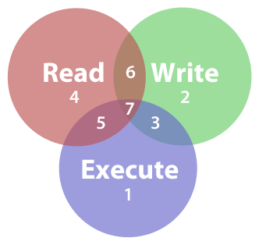
Properties of TMs
A TM has infinite tape as its unlimited memory
It has a “tape head” (think pointer) that can
Read symbols
Write symbols
Move around on the tape?
Do you see a similarity to a different set of computer functions?

Slide 11
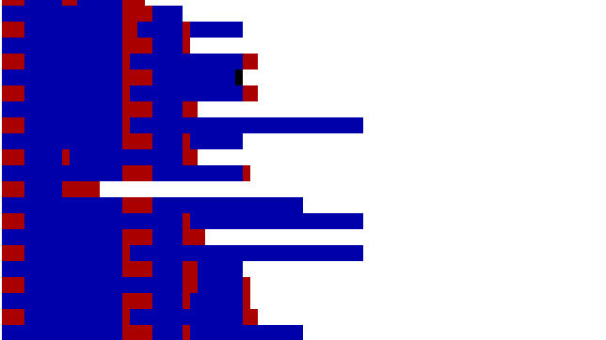
So what are we looking at?
Just the input in the tape
Followed by a whole lota white space!
Otherwise called blanks

Slide 12
Different between an FA and a TM:
A Turing machine can both write and read from the tape
A FA would just read instructions
A Turing machine can move both left and right
A FA would obey transition rules
The tape is infinite
At some point you need to stop a FA
As soon as you reach an accept or reject space, you’re done
An FA could loop back…
What do you the last point means?

Slide 13

Our first TM
Let’s see how a TM would solve the problem
$$B=\left\{w\#w \right|w∈{\left\{0,1\right\}}^{∗}\}$$
On first glance, this looks like a simple repeating word language (we’ve done there many times)
So how would a TM solve it?

Slide 14

Formal definition of a TM
A Turing machine is a 7-tuple, $Q,\text{Σ},Γ, δ, q_{0}, q_{accept}, q_{reject}$ where:
$$Q is the set of states$$
$$\text{Σ} \text{is} \text{the} \text{input} \text{alphabet} \text{not} \text{containing} \text{the} \text{blank} \text{symbol} \text{or}\text{ ⎵}$$
$$Γ is the tape alphabet, where \text{⎵}∈Γ and \text{Σ}\text{⊆}Γ$$
$$δ:Q x Γ→QxΓx\left\{L,R\right\} is the transition function$$
$$q_{0}∈Q is the start state$$
$$q_{accept}∈Q is the accept state$$
$$q_{reject}∈Q is the reject state where q_{reject}≠q_{accept}$$

Slide 15


How this works:
A TM (called M) computes by
Accepting input from the leftmost side of the tape (n squares) where input is of the form:
$w_{1}w_{2}w_{3}…w_{n}∈\text{∑}\text{∗ }$
The tape head starts at the leftmost square in ∑
The computation than proceeds based on the rules in $δ$ the transition function
If M tries to move past the left edge of the tape or past the right edge, it remains in the same place
Do you see how that could cause an error with your machine?
The computation continues until it enters the accept or reject states and at only those points does it halt

Slide 16
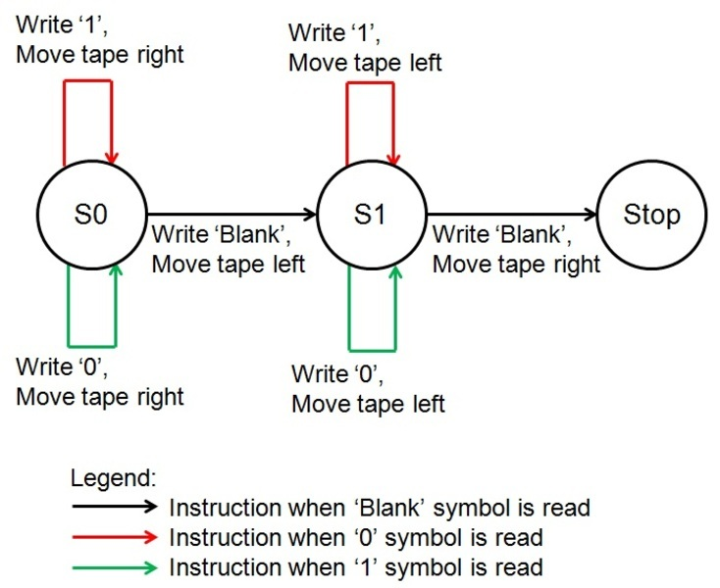
States
As the computation works, the states change
States are represented by the moves that you do in computation, like in this machine that reverses bits (like 0001 1110)

Slide 17


Configuration
At each step of computation, the TM’s configuration changes
The configuration is based on 3 items:
The current state
The current tape contents
The current head location
Do all of these remind you of something?
$$δ:Q x Γ→QxΓx\left\{L,R\right\} is the transition function$$

Slide 18
The problem space
There are things a TM can do and things that it can’t
A language is called Turing-recognizable if some TM recognizes it
A language is called Turing-Decidable if some TM decides it

